Slide 1

hAND Gesture DETECTION
Presented By: Group 2
Tejaswini Koli
Rishitha Reddy Kasireddy
Chaitanya Reddy
Harshitha Pasupula

Slide 2

OUR BIG IDEA
Overall, the big idea behind hand sign detection is to leverage technology and create more inclusive and accessible world, where communication barriers for sign language users are significantly reduced or eliminated.

Slide 3
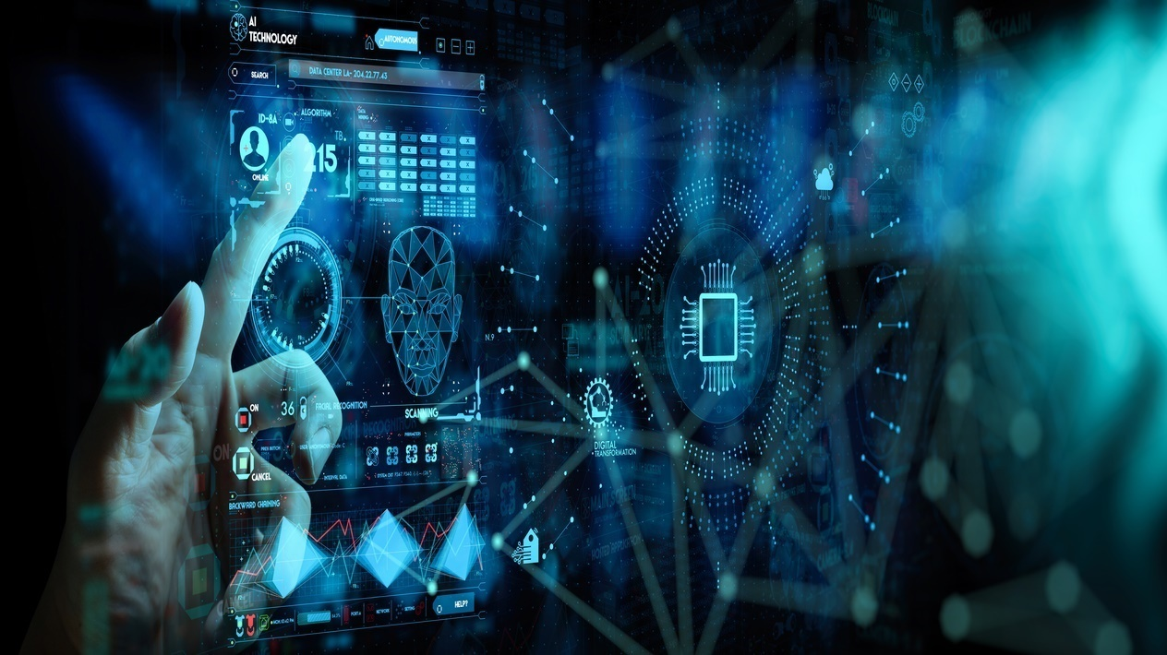
Introduction
Hand gestures constitute another important mode of human communication that could be adopted for human-computer interactions.
Recent progress in camera systems, image analysis and machine learning have made optical-based gesture recognition a more attractive option in most contexts than approaches relying on wearable sensors.
Our main aim of the project is to set the stage by highlighting the significance of hand sign detection in communication, emphasizing its impact and inviting the audience to explore the journey of this transformative project.

Slide 4
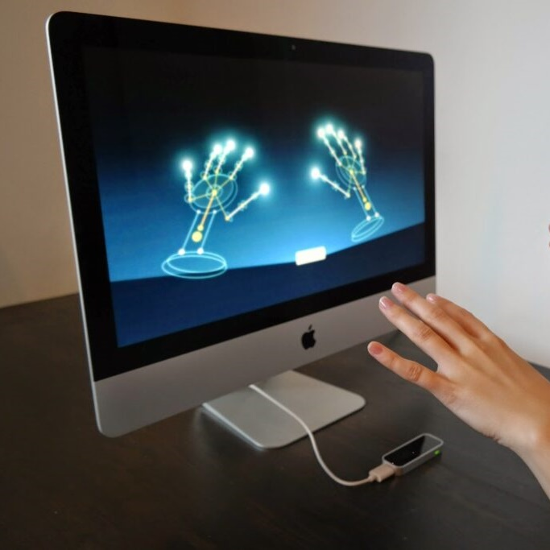
IMPLEMENTATION DETAILS
We used a dataset which having 1000 training samples for each sign and 500 validation samples.
Experimented with model configurations, including dropout rates, epochs, and filters .
Visualized training accuracy, training loss, validation accuracy and validation loss

Slide 5
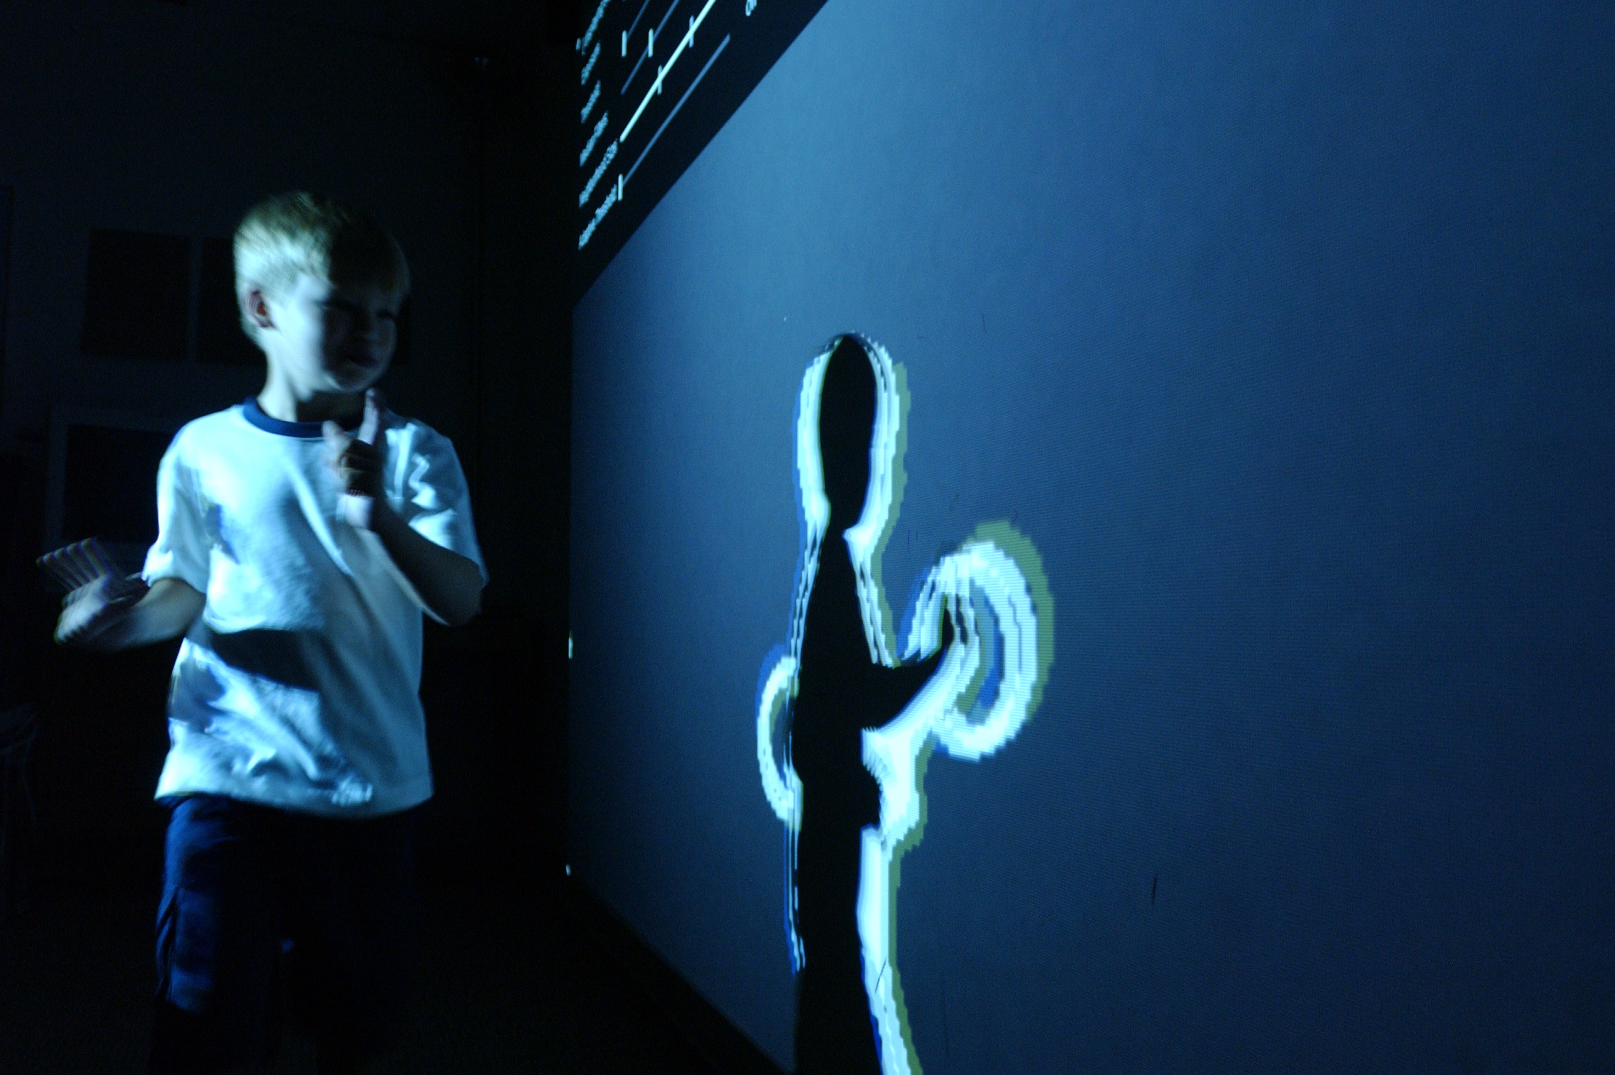
Model CONFIGURATIONS:
With TensorFlow serving as the backend and
the Keras API for convolutional neural
networks (CNNs), we are obtaining the
following validation accuracy.
Initial try: 100% after taking 25 epochs, dropout of 0.25, batch normalization, and spatial sampling using max pooling 2D.
Finalized combination: The validation accuracy is 97.15% when we decrease the epoch to 5 and increase dropout to 0.5.

Slide 6
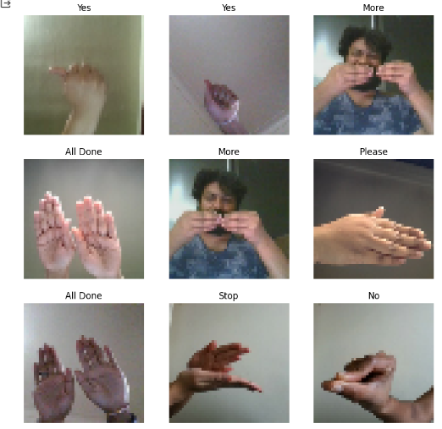
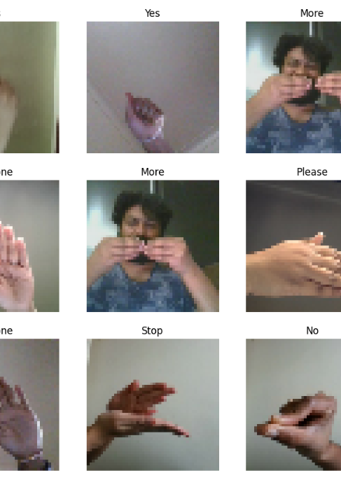
Results
We have tested our model with different dropout values and epochs to avoid overfitting.
No: of Epoch's | Dropout | Train accuracy | Validation accuracy
25 | 0.25 | 100% | 100%
25 | 0.5 | 100% | 100%
10 | 0.5 | 100% | 100%
5 | 0.5 | 99.88% | 97.15%
7 | 0.6 | 99.68% | 86.75%
10 | 0.6 | 99.77% | 94.44%

Slide 7
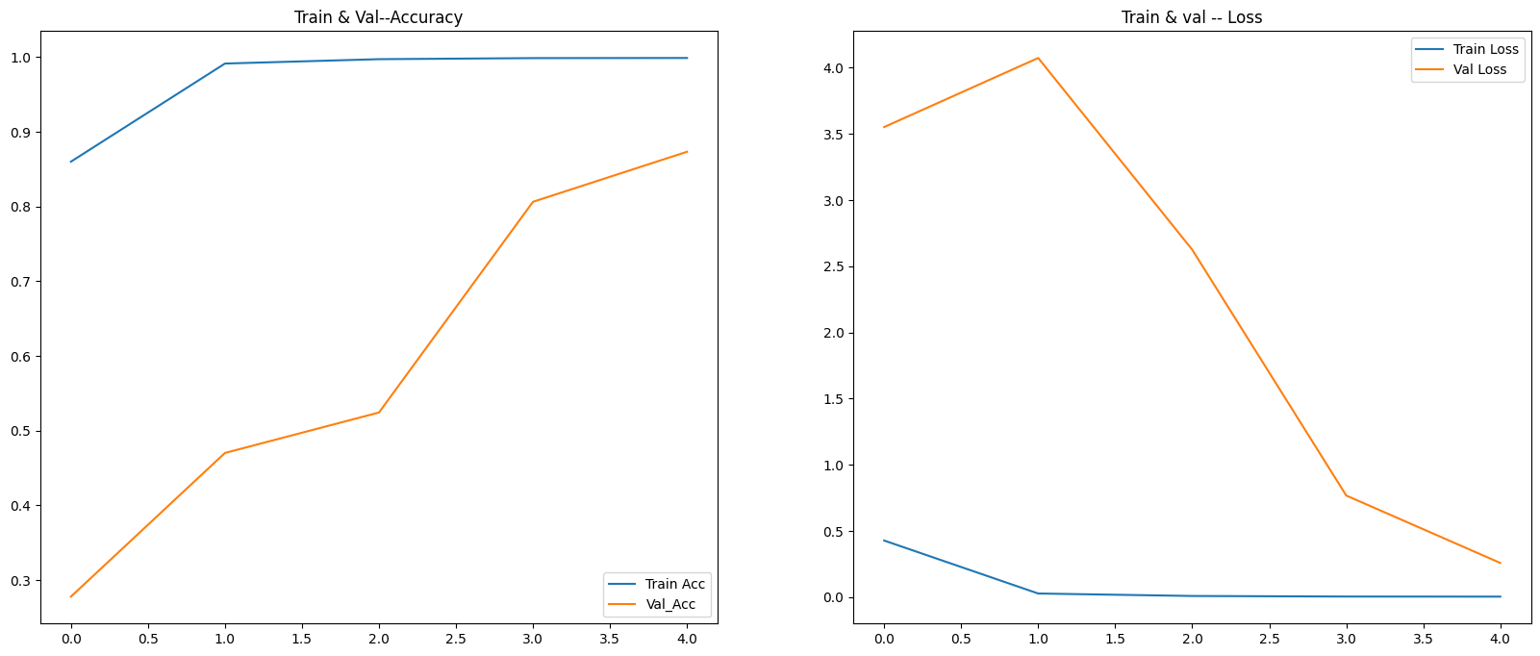
Training and validation plots
The below is the training and validation plots for accuracy and loss
Epochs- 0.5
3 layers (nodes used 16, 24, 32)
Dropout- 0.5

Slide 8
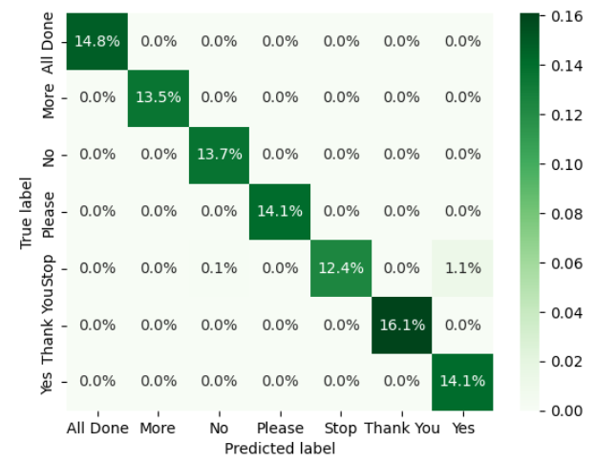
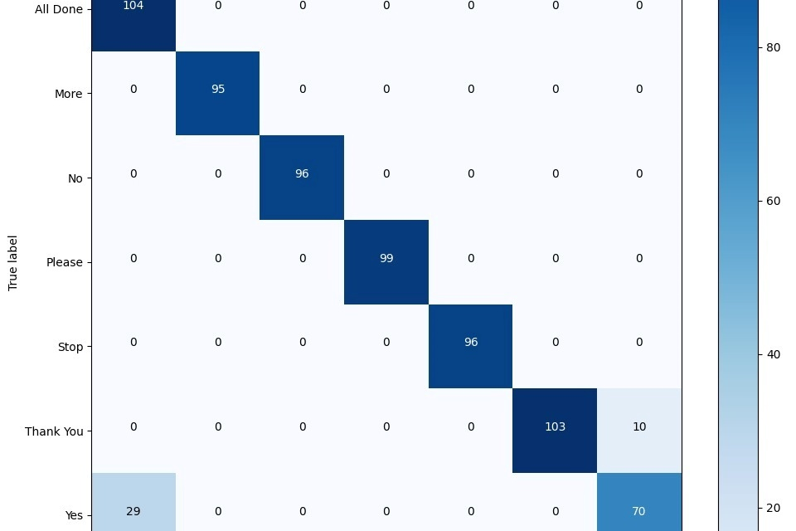
CoNfusion Matrix
We have used confusion matrix to know the correlation between all the signs.
Only Yes is related with Stop

Slide 9

Challenges and Limitations
Occlusion
Lighting Conditions
Variability in Hand Shapes

Slide 10
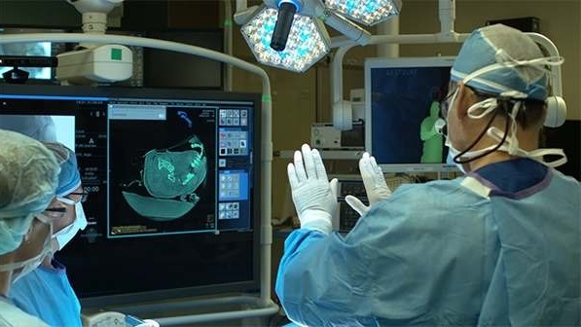
Conclusion
This conclusion encapsulates the significance of the hand sign detection project , technological advancements, impactful applications, and a commitment to inclusivity, leaving the audience with a sense of the project's broader implications and its potential to shape a more inclusive future.

Slide 11
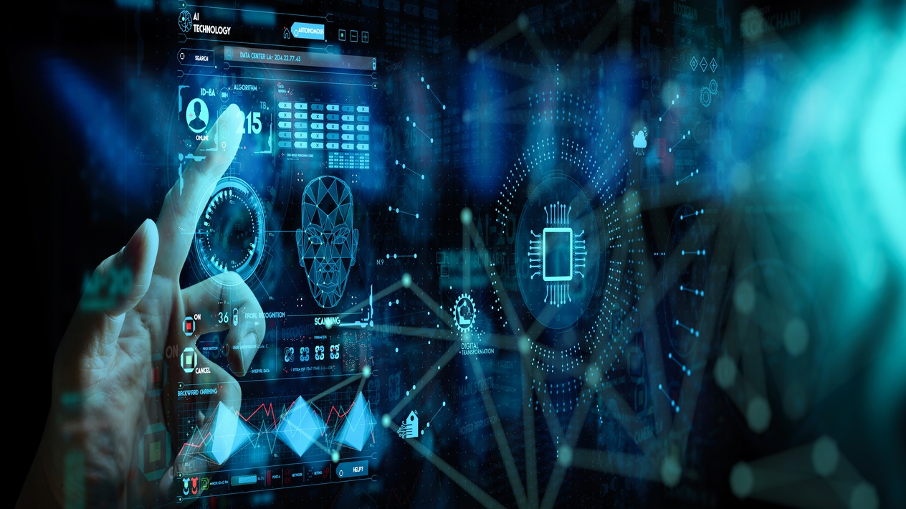
Thank You

